Slide 2
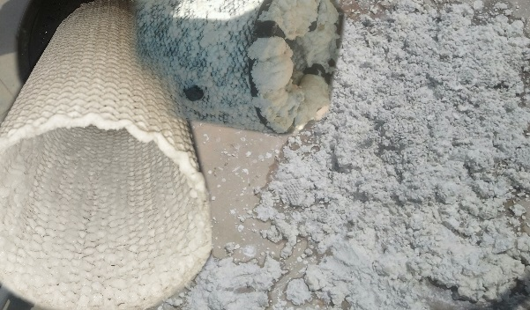
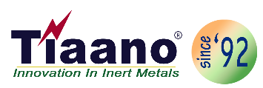
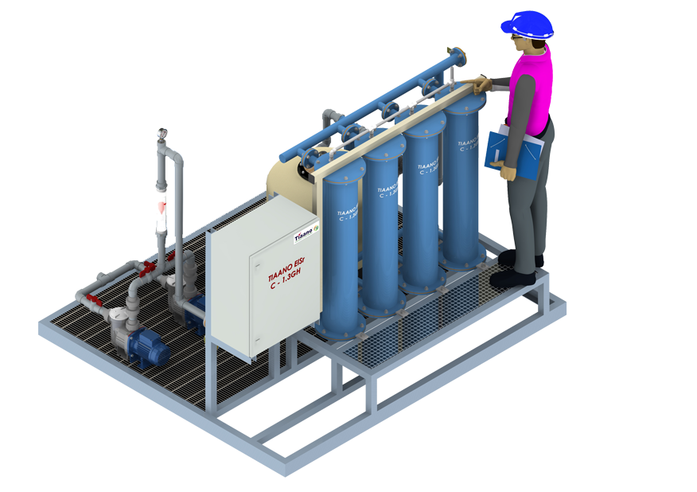
Tiaano Profile
Based on over 20 years design and manufacturing capacity of MMO coated / DSA activated anode production, Tiaano India established design, supply, installation, commissioning & operation of “Tiaano ElSr-RO” an combination of Electrolytic Scale Remover and Dechlorination by UV irradiation.
Chemical
&
Media Free
Pretreatment for RO Systems
.Phone: +91 44 2278 1148
Email: elsrmktg@tiaano.com
Web: www.scaleseparator.com

Slide 3
Critical Problems in Bottling, Power & Pharma Water:
Scale precipitation in RO
Chlorine / Sodium hypochlorite removal before RO
Biological & Algae growth
Chemical
&
Media Free
Pretreatment for RO Systems
.Phone: +91 44 2278 1148
Email: elsrmktg@tiaano.com
Web: www.scaleseparator.com

Slide 4
Critical Problems in Bottling, Power & Pharma Water:
Softeners:
Hard to sanitize
Constant salt addition
Collects contamination
High water consumption
Resin attacked by chlorine
Disposal for the spent softener regenerate
Chemical
&
Media Free
Pretreatment for RO Systems
.Phone: +91 44 2278 1148
Email: elsrmktg@tiaano.com
Web: www.scaleseparator.com

Slide 5
Critical Problems in Bottling, Power & Pharma Water:
Antiscalant:
Contamination of Antiscalant is common
Hard to control, susceptible to feed fluctuations
Proof needed of no presence in permeate
Possible problems of concentrate disposal
When dosing interrupted, system fails
System typically cleaned frequently
Maintaining stock
Chemical
&
Media Free
Pretreatment for RO Systems
.Phone: +91 44 2278 1148
Email: elsrmktg@tiaano.com
Web: www.scaleseparator.com

Slide 6
Critical Problems in Bottling, Power & Pharma Water:
Active carbon filter (ACF)
Closed cylinder with Activated Carbon media
Generates carbon fines
High and quick buildup of microorganisms
Steaming or Hot Water Sanitization is must
Chemical
&
Media Free
Pretreatment for RO Systems
.Phone: +91 44 2278 1148
Email: elsrmktg@tiaano.com
Web: www.scaleseparator.com

Slide 7
Critical Problems in Bottling, Power & Pharma Water:
Sodium Bi Sulfate (SBS) Injection
Problematic instrumentation (ORP)
Low reliability
High maintenance
Tendency to over dose
Fouls the RO membranes
High water waste
SBS Contamination common
Chemical
&
Media Free
Pretreatment for RO Systems
.Phone: +91 44 2278 1148
Email: elsrmktg@tiaano.com
Web: www.scaleseparator.com

Slide 8
Critical Problems in Bottling, Power & Pharma Water:
Chemical Sanitization for equipment
Dangerous chemical handling
Post sanitization, validation needed
High manpower involved
Uncertain and unreliable results
Chemical
&
Media Free
Pretreatment for RO Systems
.Phone: +91 44 2278 1148
Email: elsrmktg@tiaano.com
Web: www.scaleseparator.com

Slide 9
Our Solution; ElSr-RO Chemical & Media free System:
Removal of scales by Electrolytic Scale Remover (ElSr)
Removal of available chlorine by UV radiation(UVDC)
Continuous bio burden reduction.
Chemical
&
Media Free
Pretreatment for RO Systems
.Phone: +91 44 2278 1148
Email: elsrmktg@tiaano.com
Web: www.scaleseparator.com

Slide 10
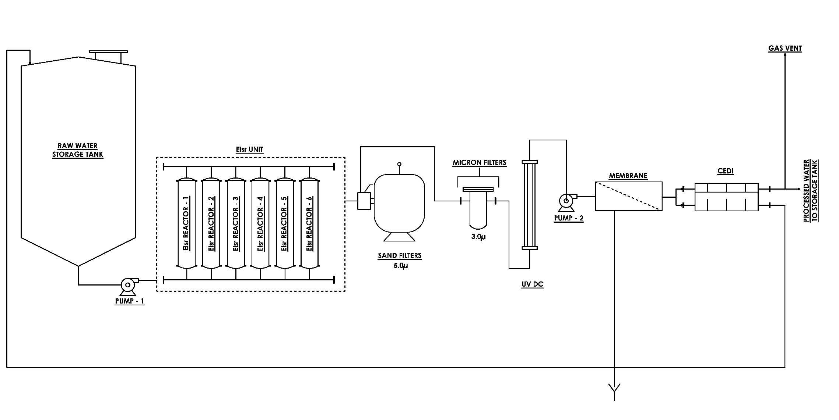
Our Solution; ElSr-RO Chemical & Media free System:
PFD of Tiaano ElSr-RO
Chemical
&
Media Free
Pretreatment for RO Systems
.Phone: +91 44 2278 1148
Email: elsrmktg@tiaano.com
Web: www.scaleseparator.com

Slide 11
Our Solution; ElSr-RO Chemical & Media free System: Electrolytic Scale Remover - Tiaano ElSr
Electrically powered separation of scale in Reactor
Partial electrolysis to change dynamic equilibrium conditions.
Allowing longer retention time in RO without scale formation.
Chemical
&
Media Free
Pretreatment for RO Systems
.Phone: +91 44 2278 1148
Email: elsrmktg@tiaano.com
Web: www.scaleseparator.com

Slide 12
Our Solution; ElSr-RO Chemical & Media free System: Process - Tiaano ElSr
Electrical field splits water into OH- and H+
Low pH in the vicinity of the Anode
High pH in the vicinity of the Cathode
High pH is the key factor for precipitation
High pH will cause scale to deposit in cathode
Fluffy scale is formed & removed from bottom of reactor
Chemical
&
Media Free
Pretreatment for RO Systems
.Phone: +91 44 2278 1148
Email: elsrmktg@tiaano.com
Web: www.scaleseparator.com

Slide 13
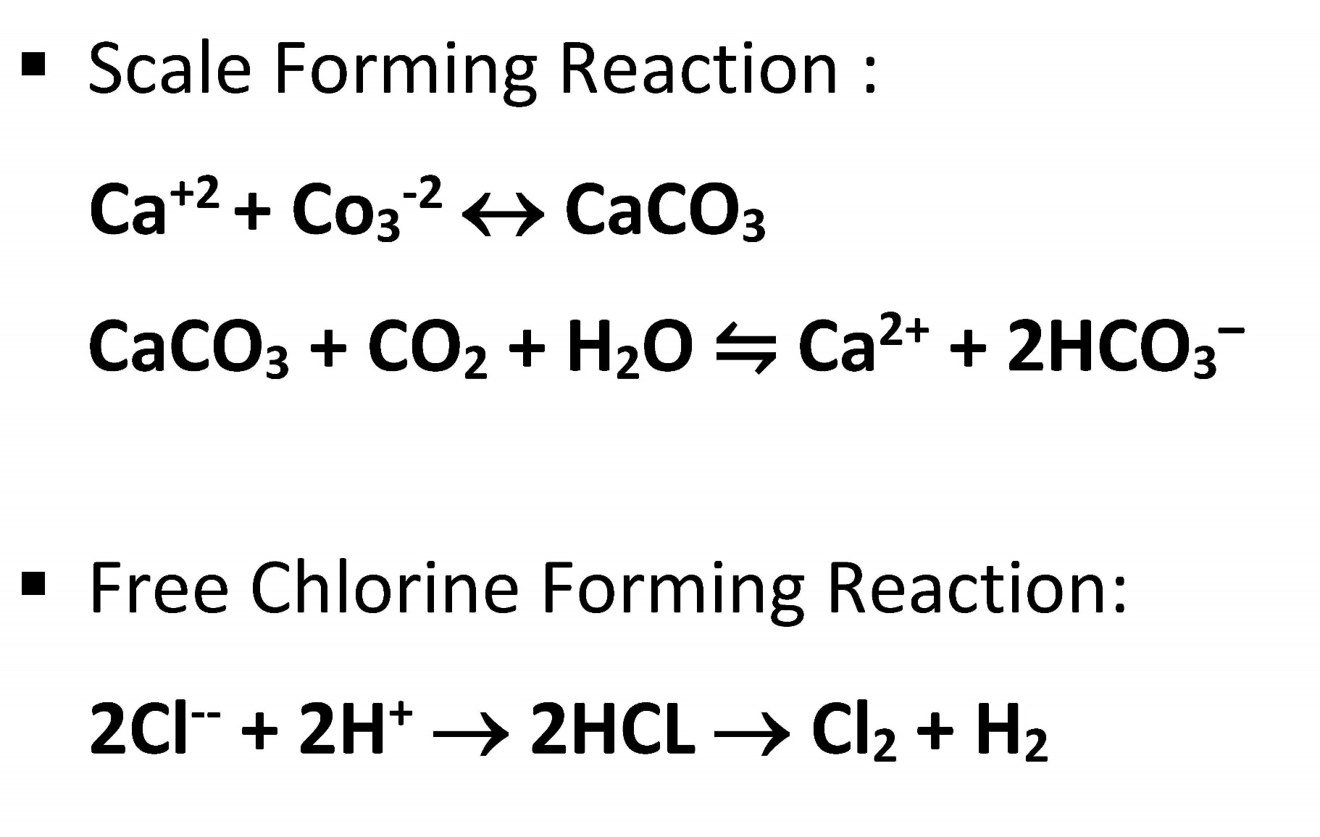
Our Solution; ElSr-RO Chemical & Media free System: Process of Tiaano ElSr
Chemical
&
Media Free
Pretreatment for RO Systems
.Phone: +91 44 2278 1148
Email: elsrmktg@tiaano.com
Web: www.scaleseparator.com

Slide 14
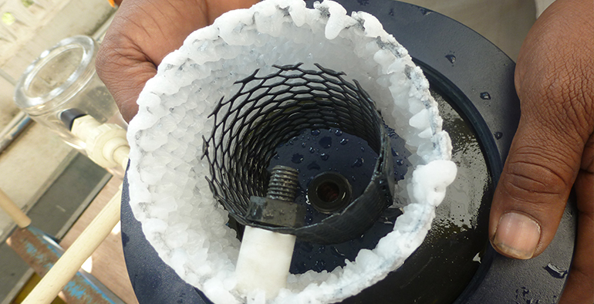
Our Solution; ElSr-RO Chemical & Media free System: Scale deposition in Reactor
Chemical
&
Media Free
Pretreatment for RO Systems
.Phone: +91 44 2278 1148
Email: elsrmktg@tiaano.com
Web: www.scaleseparator.com

Slide 15
Our Solution; ElSr-RO Chemical & Media free System: Tiaano ElSr - Advantages
ElSr will precipitate all scale forming ions, not only Magnesium, Calcium but also Silicates (silica), Ferrites (ferum), Manganese and other cations which are all not removed by softeners.
Reductions in RO maintenance, fouling and cleaning.
RO load will be reduced
Chemical
&
Media Free
Pretreatment for RO Systems
.Phone: +91 44 2278 1148
Email: elsrmktg@tiaano.com
Web: www.scaleseparator.com

Slide 16
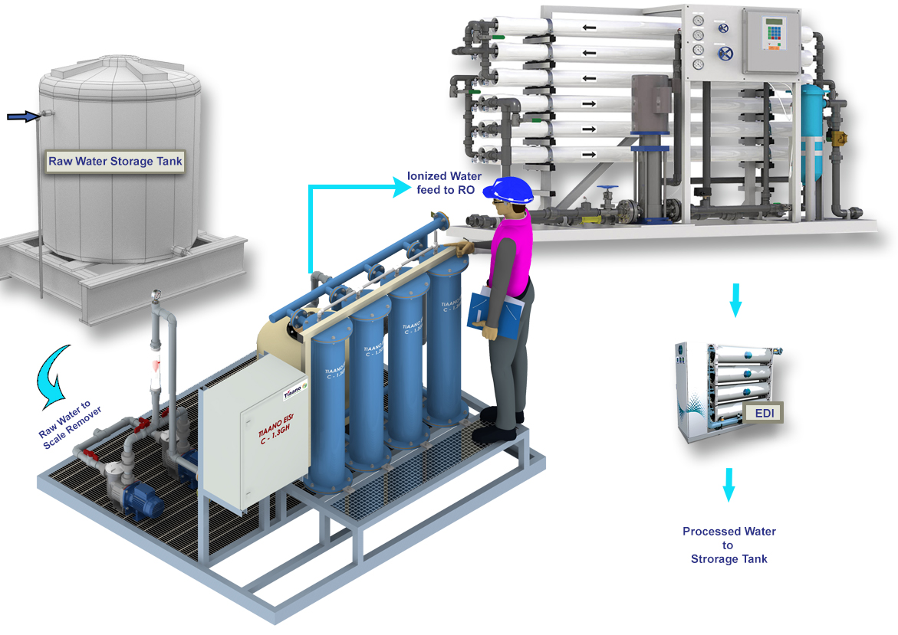
Our Solution; ElSr-RO Chemical & Media free System: Tiaano ElSr-RO Site installations
Chemical
&
Media Free
Pretreatment for RO Systems
.Phone: +91 44 2278 1148
Email: elsrmktg@tiaano.com
Web: www.scaleseparator.com

Slide 17
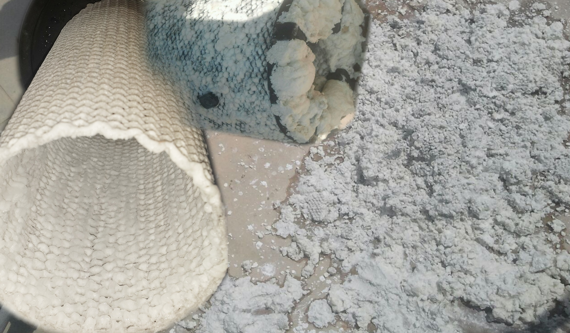
Our Solution; ElSr-RO Chemical & Media free System:
Scale formation and removal
Chemical
&
Media Free
Pretreatment for RO Systems
.Phone: +91 44 2278 1148
Email: elsrmktg@tiaano.com
Web: www.scaleseparator.com

Slide 18
Our Solution; ElSr-RO Chemical & Media free System: De-Chlorination by UV irradiation (UVDC)
Decompose the free chlorine into O2 and Chloride
Chloride & Sodium ion are stopped by the RO membrane
Bacteria destruction
Chemical
&
Media Free
Pretreatment for RO Systems
.Phone: +91 44 2278 1148
Email: elsrmktg@tiaano.com
Web: www.scaleseparator.com

Slide 19
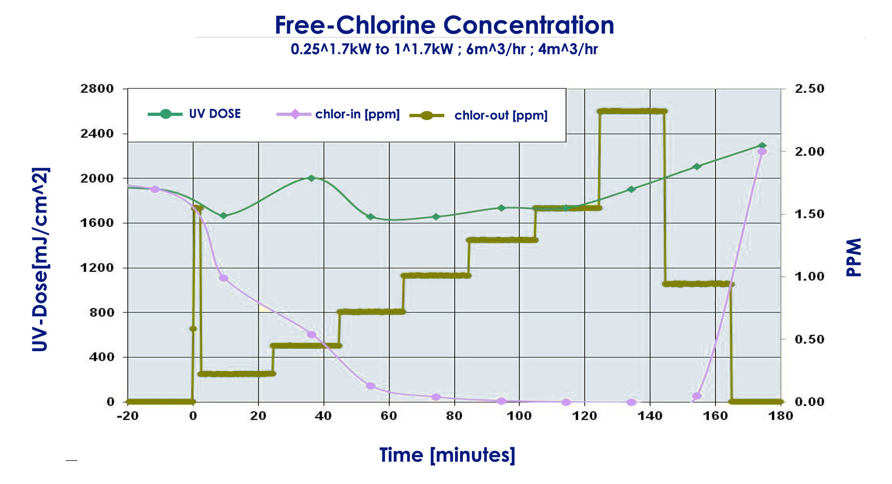
Our Solution; ElSr-RO Chemical & Media free System:
De-Chlorination by UV irradiation (UVDC)
Chemical
&
Media Free
Pretreatment for RO Systems
.Phone: +91 44 2278 1148
Email: elsrmktg@tiaano.com
Web: www.scaleseparator.com

Slide 20
Our Solution; ElSr-RO Chemical & Media free System:
Continues bio-burden reduction
Inherent destruction of bacteria by normal continuous operation
No need of maintenance, cleaning or sanitization
Chemical
&
Media Free
Pretreatment for RO Systems
.Phone: +91 44 2278 1148
Email: elsrmktg@tiaano.com
Web: www.scaleseparator.com

Slide 21
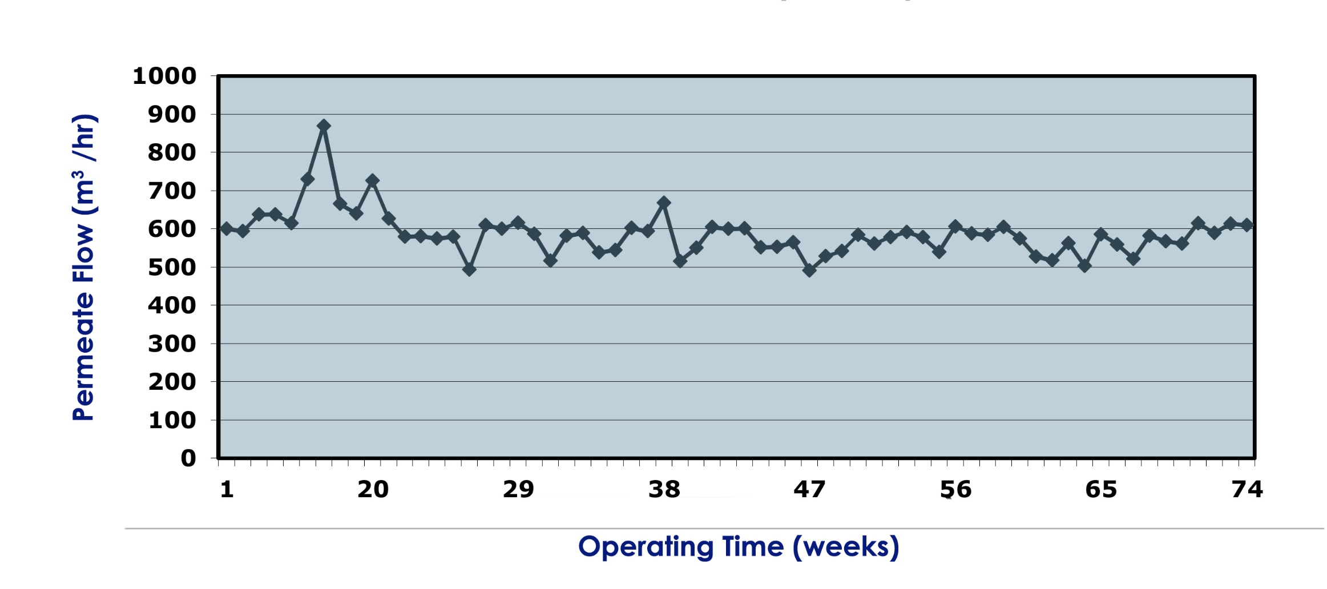
Continuous Membrane Performance
Permeate Flow
No deterioration of the membrane over a year of operation
Chemical
&
Media Free
Pretreatment for RO Systems
.Phone: +91 44 2278 1148
Email: elsrmktg@tiaano.com
Web: www.scaleseparator.com

Slide 22
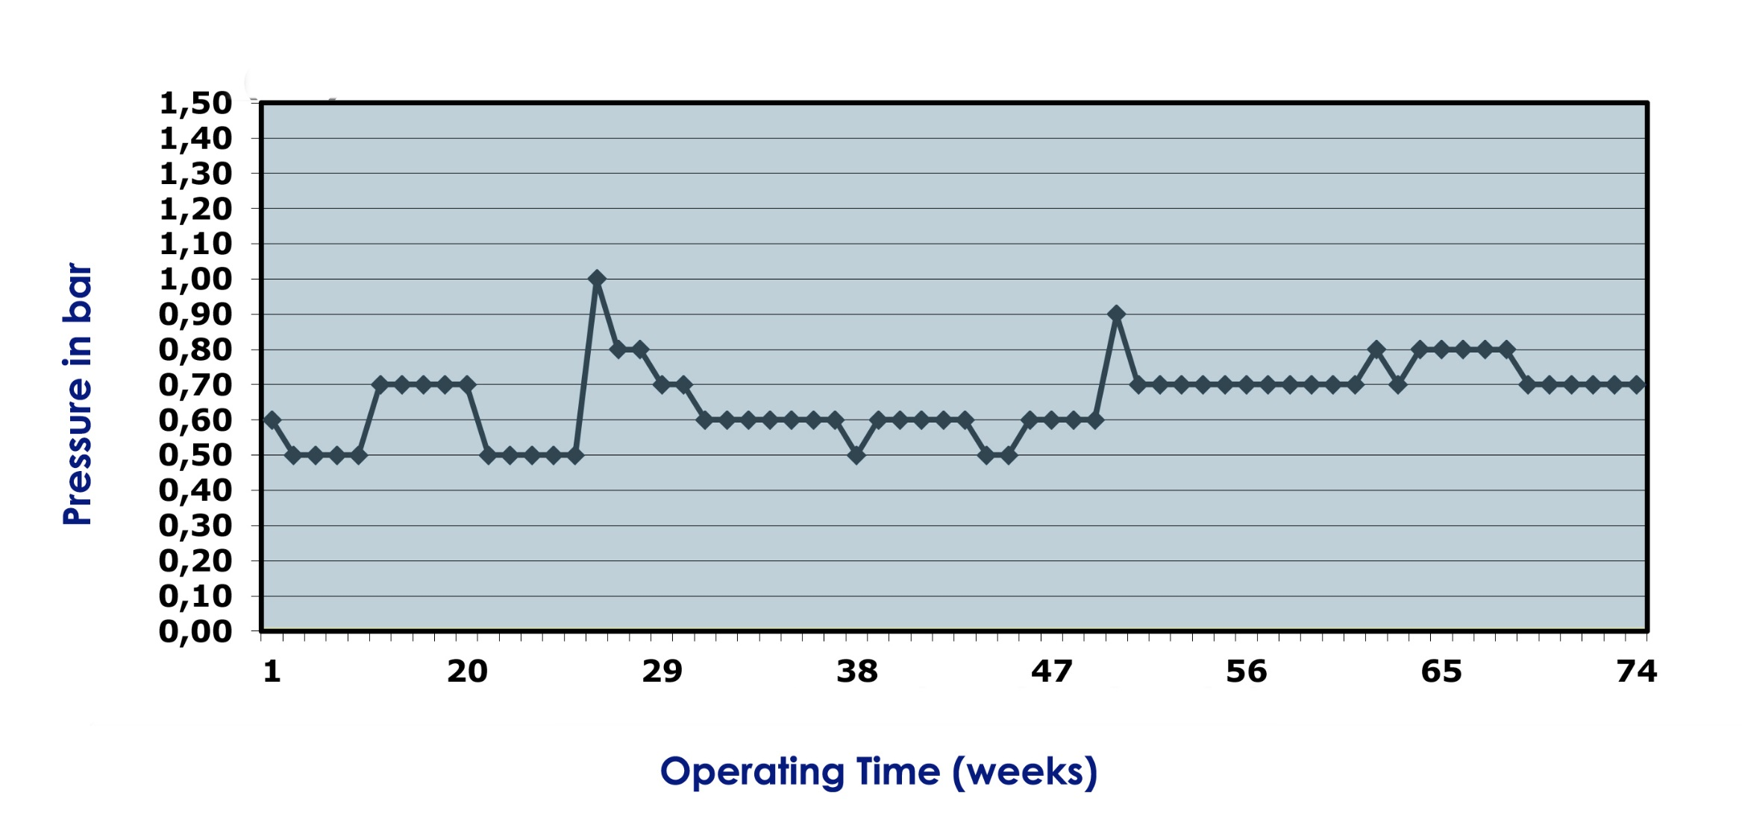
Continuous Membrane Performance
Differential Pressure
No deterioration of the membrane over a year of operation
Chemical
&
Media Free
Pretreatment for RO Systems
.Phone: +91 44 2278 1148
Email: elsrmktg@tiaano.com
Web: www.scaleseparator.com

Slide 23
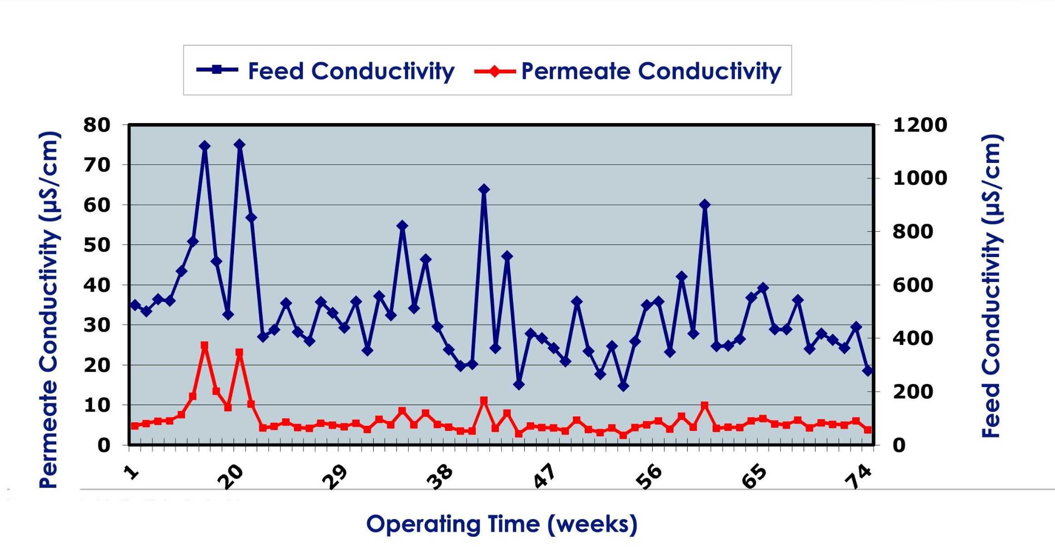
Continuous Membrane Performance
Conductivity
No deterioration of the membrane over a year of operation
Chemical
&
Media Free
Pretreatment for RO Systems
.Phone: +91 44 2278 1148
Email: elsrmktg@tiaano.com
Web: www.scaleseparator.com

Slide 24
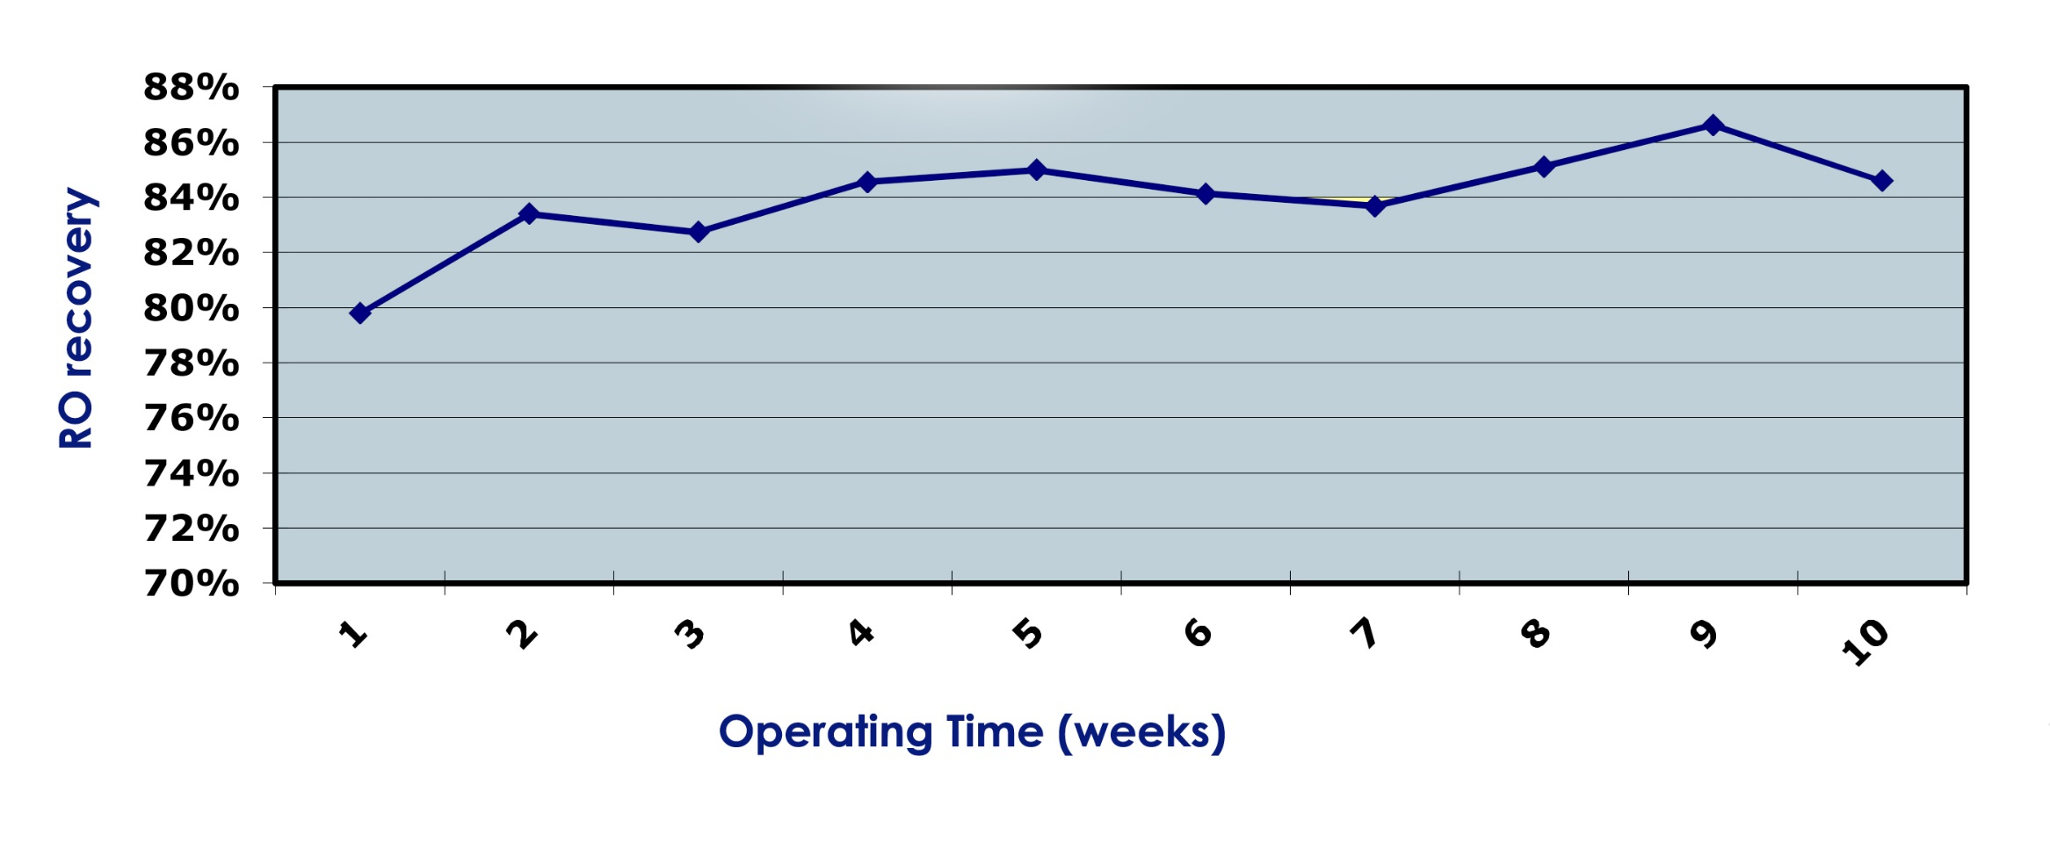
Continuous Membrane Performance
RO Recovery %
RO Recovery over 80% with no chemicals
Chemical
&
Media Free
Pretreatment for RO Systems
.Phone: +91 44 2278 1148
Email: elsrmktg@tiaano.com
Web: www.scaleseparator.com

Slide 25
Green Technology – Cost Reduction
Reliability and clean operation - Savings in Maintenance
Water savings compared to Softeners and ACF
No Salt, No Chemicals – No purchase & Solution makeup
No high chloride effluent
Low energy consumption
Chemical
&
Media Free
Pretreatment for RO Systems
.Phone: +91 44 2278 1148
Email: elsrmktg@tiaano.com
Web: www.scaleseparator.com

Slide 26
Low Maintenance
ElSr - Monthly removal of Scale deposit.
Filters - Monthly washing of filters or replacing filters.
UVDC - Replace UV lamp, Gasket, wash every 6 months.
RO / CEDI – No additional maintenance needed.
Hard to quantify cost of down time
Chemical
&
Media Free
Pretreatment for RO Systems
.Phone: +91 44 2278 1148
Email: elsrmktg@tiaano.com
Web: www.scaleseparator.com

Slide 27
No Chemicals & No Salt
No Antiscalant
No Hypochlorite
No Sodium Bisulfite (SBS).
No need to add salt.
Reduction of brine makers footprint & dry salt storage.
Chemical
&
Media Free
Pretreatment for RO Systems
.Phone: +91 44 2278 1148
Email: elsrmktg@tiaano.com
Web: www.scaleseparator.com

Slide 28
Water Saving
Softeners can waste 5-15% of product water
Industrial RO pretreatment can drain 10-50% of product water, when use softeners as pretreatment equipment to RO.
ElSr-RO process doesn’t consume water!
Chemical
&
Media Free
Pretreatment for RO Systems
.Phone: +91 44 2278 1148
Email: elsrmktg@tiaano.com
Web: www.scaleseparator.com

Slide 29
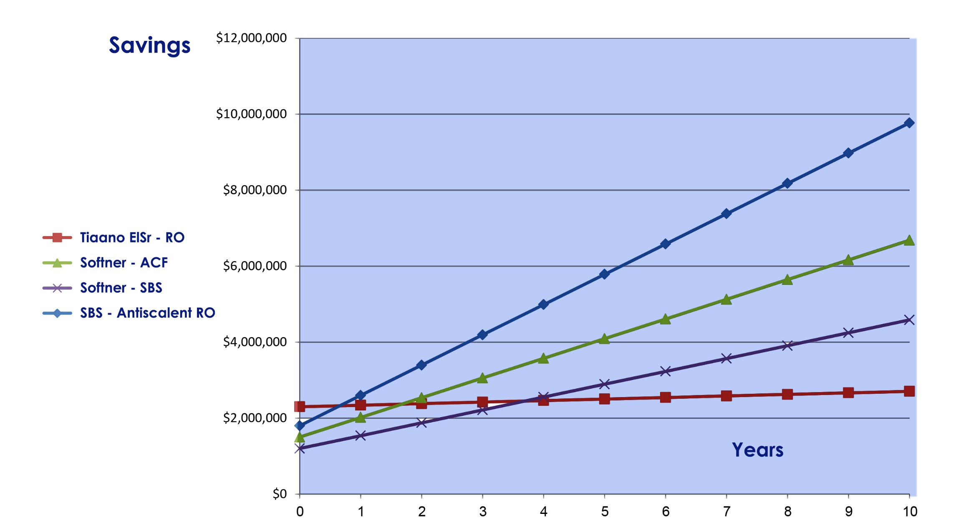
Yearly Savings Calculation, when use Tiaano ElSr-RO
Chemical
&
Media Free
Pretreatment for RO Systems
.Phone: +91 44 2278 1148
Email: elsrmktg@tiaano.com
Web: www.scaleseparator.com

Slide 30
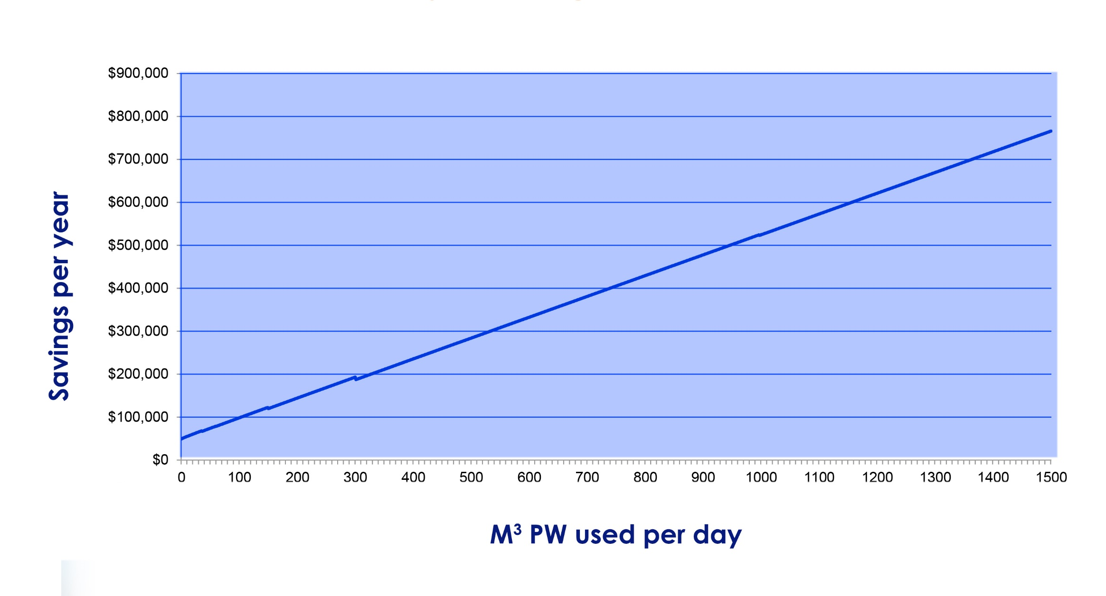
Life Cycle Savings Calculation,
when use Tiaano ElSr-RO
Chemical
&
Media Free
Pretreatment for RO Systems
.Phone: +91 44 2278 1148
Email: elsrmktg@tiaano.com
Web: www.scaleseparator.com

Slide 31
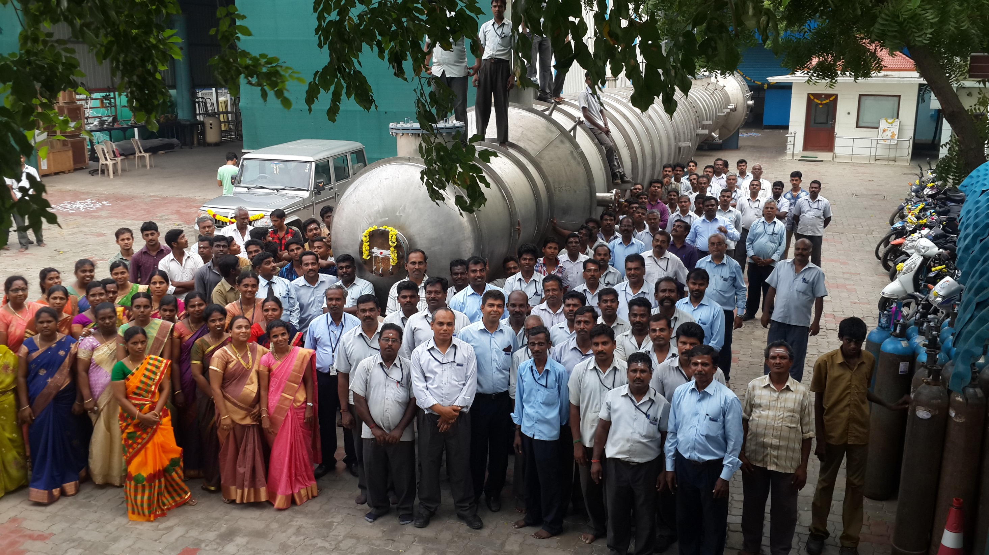
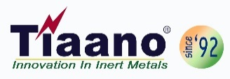
Admin & Manufacturing:
Ti Anode Fabricators Pvt. Ltd.
#48, Noothanchary, Madambakkam, Chennai- 600126, India.
Phone: +91 94445 69900, +91 44 2278 1148, Fax: 2278 1362
Email: elsrmktg@tiaano.com, tianode@gmail.com, Web: www.scaleseparator.com

